Slide 1
7CS034 - Data Science Assessment Presentation
School of Mathematics and Computer Science
Faculty of Science and Engineering
Unpacking Income Disparities: A Socioeconomic Analysis
Exploring the Dynamics of Income Inequality Across Diverse Demographics
Presented by:
Solagbade Akande < 2417206 >
< 7th November 2024 >

Slide 2
Exploring Income Disparities through Data Analysis
Objective: Investigate the factors driving income disparities across demographics.
Overview
Insights from in-depth analysis on a demographic census data set (Household Census Data, 2021)
Uncovering interactions between key variables
Bringing findings to life with impactful visualizations (Wickham et al., 2023)
Key Steps: Data Cleaning ➔ Analysis ➔ Visualization ➔ Insights
Key Variables: Income, Age, Gender, Education Level, Marital Status
Statistic Preview: Overall gender-based income gap of about 88.45% observed
Could education be the key to bridging this income gap? Let’s explore…

Slide 3
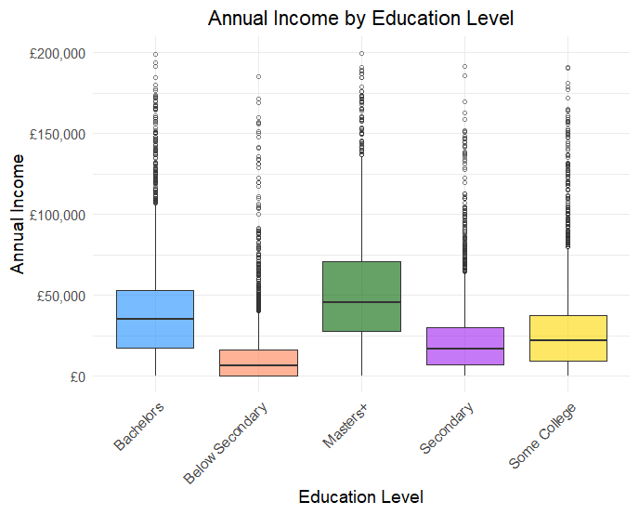
Education as a Pathway to Financial Stability
Key Insight: Education boosts income, though gains vary.
Masters+ Earn Most: Higher degrees yield top average incomes.
Below Secondary Earn Least: Lower education limits earning potential.
Yet, do these educational gains impact everyone equally? The next slide reveals the gender-specific story behind the numbers.

Slide 4
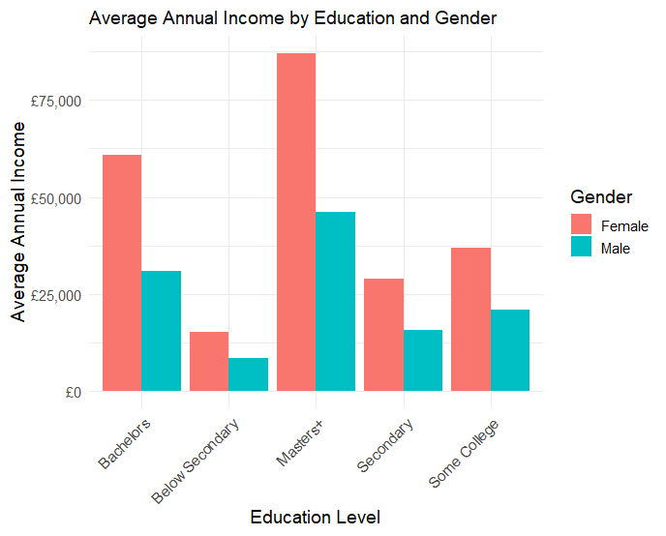
Do Men and Women with Similar Education Earn Equally?
Key Insight: Our analysis uncovers a new finding: in this population, women earn more than men across all education levels, especially at advanced levels.
Takeaway: Education raises incomes, but systemic barriers sustain gender gaps.
Next, we explore if women earn more than men across demographics and what drives higher earnings for women.

Slide 5
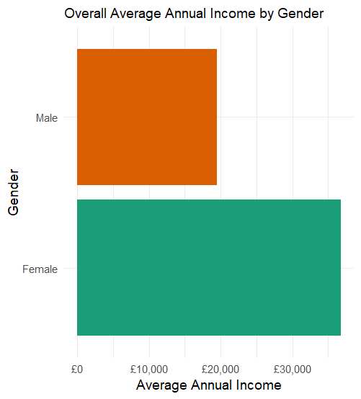
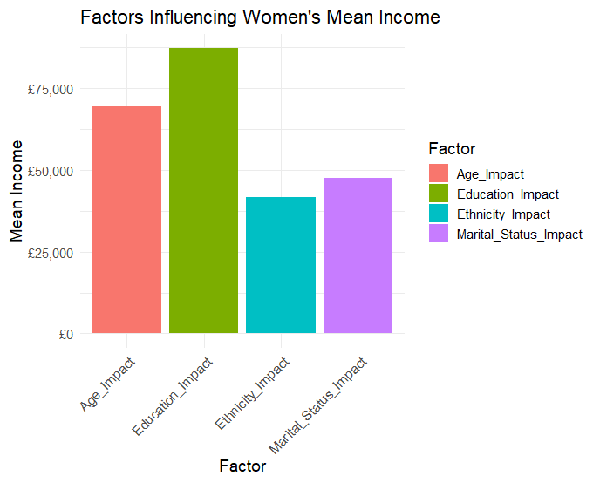
Do Women Out-earn Men Across All Demographics in This Census Data?
Women, on average, earn more than men in this dataset—an unusual trend compared to typical income patterns.
Education and Age are significant factors driving women's higher income.

Slide 6
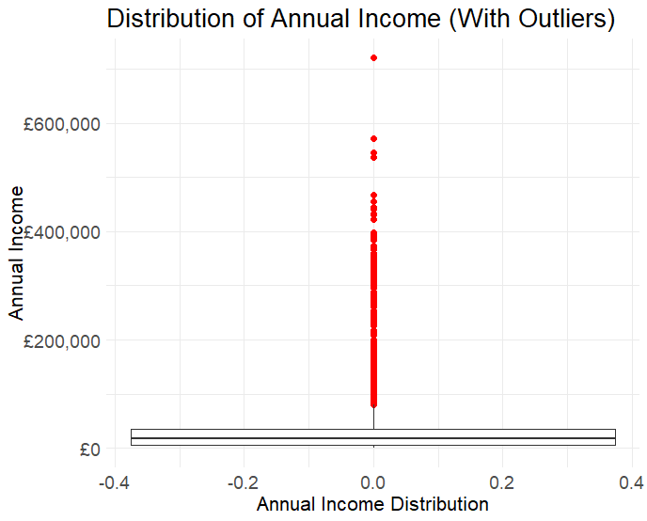
Data Set Limitations and Key Insights Summary
Scope & Missing Data: Limited demographics and missing values, especially in income and marital status, may impact accuracy.
Income Outliers: High-income outliers (up to £720,000) could distort analysis.
Gender Encoding: 'Female' column uses 0 for Female and 1 for Male, which may cause confusion with conventional binary notation.
Correlation vs. Causation: Relationships observed here are correlational, not causal.
Summary: The dataset suggests that women in this population earn more than men, potentially due to holding higher-paying roles, with education being a significant factor. However, without specific job titles, this remains an assumption. Further research is recommended to explore earnings factors and examine barriers for men.

Slide 7
References
Household Census Data, England 2021 (2021) Modified dataset provided for assessment purposes.
Parkes, A. (2024). 7CS034 Data Science: Lecture notes. University of Wolverhampton.
Wickham, H., Çetinkaya-Rundel, M., & Grolemund, G. (2023). R for Data Science. 2nd ed. O'Reilly.

